Slide 1
Tree testing results
Website Redesign
John Smith
Feb 2016

Slide 2
What we tested
3 site trees with deliberate variations
Tree 0 = existing site
Tree 1 = new audience-centric design
Tree 2 = new action-centric design
18 tasks spread across customer segments
50-60 participants per tree
90% residential customers (existing or prospective)

Slide 3
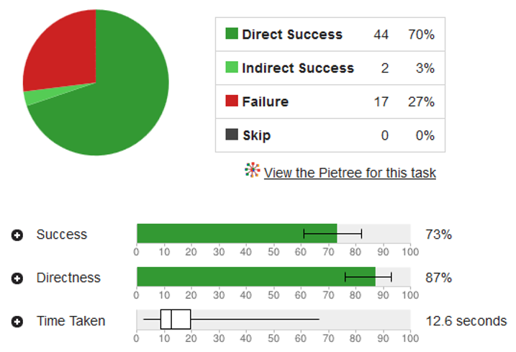
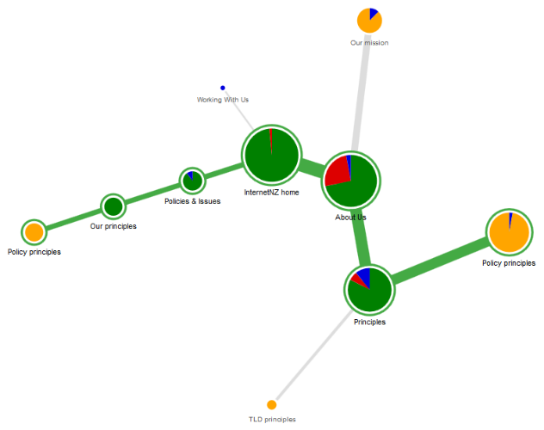
How we tested the designs
Notes:
In a tree test, we show our participant a text version of the headings and subheadings of our site – the “skeleton” of our navigation.
We give them something specific to look for, then we let them click down through the headings and subheadings until they find an answer.
The software tracks where they click, where they backtrack, and long it takes them for each task.
After we test about 50 users, we can see patterns emerging in where they succeeded, where they failed, and which headings caused problems.

Slide 4
The site trees we tested
Current site
Why join us?
Residential
Business
Agribusiness
Residential pricing
Join
Offers
Save energy & money
Residential
Business
etc.
My account
My bill
etc.
About us
Audience-centric
Residential
Plans and pricing
Offers
etc.
Small business
Plans and pricing
etc.
Corporate
Products and pricing
etc.
Farm
Plans and pricing
etc.
My Account
About us
Action-centric
Join
Join
Moving
Plans and rates
Residential plans
Business plans
etc.
Better off with us
Great online tools
etc.
Your account
My bill
How to pay
etc.
About us

Slide 5
What we wanted to find out
Which is more effective as the top-level buckets
Audience?
Actions?
Best to go with a shallow/wide tree, or deeper/narrower?
Did users understand the difference between “small/med business” and corporate?

Slide 6
Overall success rates
Current site
Why join us?
Residential
Business
Agribusiness
Residential pricing
Join
Offers
Save energy & money
Residential
Business
etc.
My account
My bill
etc.
About us
Audience-centric
Residential
Plans and pricing
Offers
etc.
Small business
Plans and pricing
etc.
Corporate
Products and pricing
etc.
Farm
Plans and pricing
etc.
My Account
About us
Action-centric
Join
Join
Moving
Plans and rates
Residential plans
Business plans
etc.
Better off with us
Great online tools
etc.
Your account
My bill
How to pay
etc.
About us
36%
64%
51%
Notes:
Both new designs performed better than the existing site tree.
The audience-centric design was the most effective for all user groups.
Etc.

Slide 7
Findings and recommendations
The separate Products and Solutions sections were continually confused by all user groups.
Combine these sections and revise their content.
The FAQ page attracted heavy (and unwanted) traffic even for basic product information.
Investigate the FAQ content to see if we can merge it into the main content areas of the site.
Etc.
etc..

Slide 8
Next steps
Susan will run a follow-up tree test combining a revision of Tree 1 with the best elements of Tree 2.
Lloyd will investigate the FAQ content.
Etc.

Slide 9
More info
Tree-test data and detailed results: http://acme.com/studies/tree-test-2016-01-15
Summary of upcoming research: http://acme.com/studies/upcoming
Questions, comments, suggestions?
Contact John Smith at x12345

